Slide 1
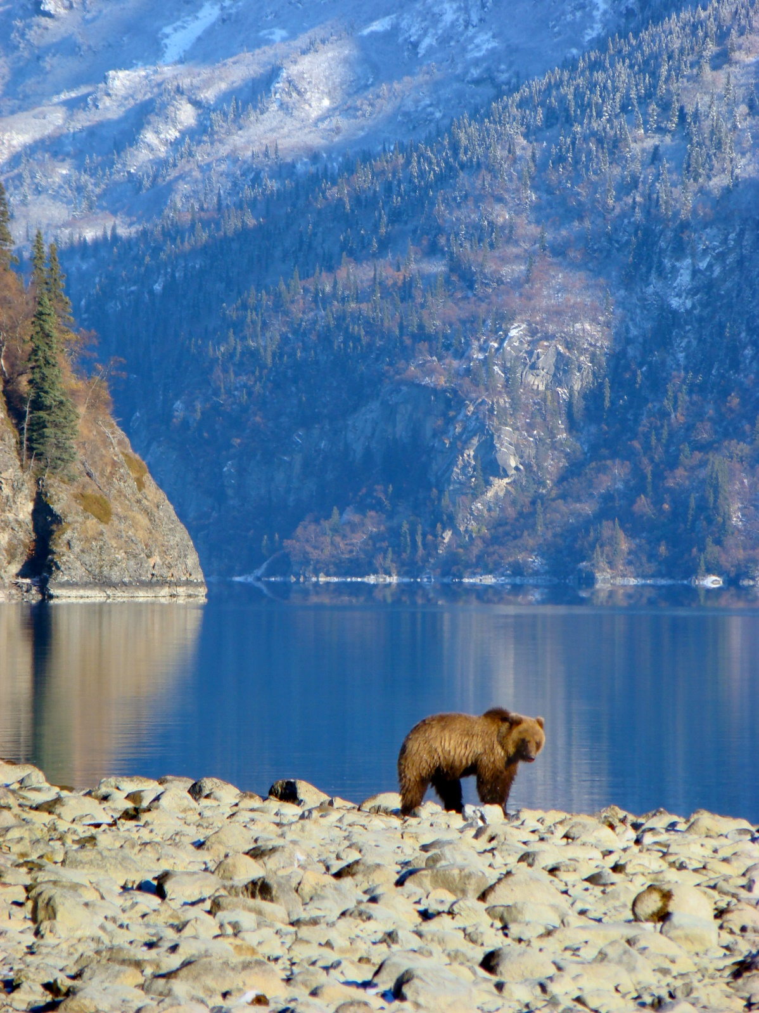
Lake Clark’s Inland Brown Bears

Slide 2
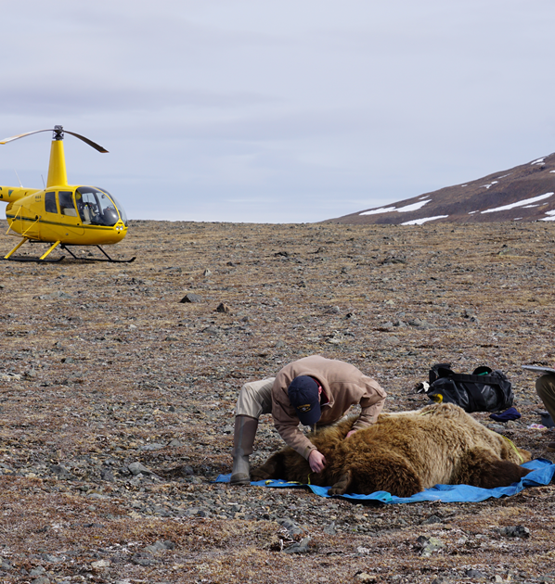
Park biologists
Park biologists fitted bears with global positioning system (GPS) radio collars to track their movements in the interior of the park.

Slide 3
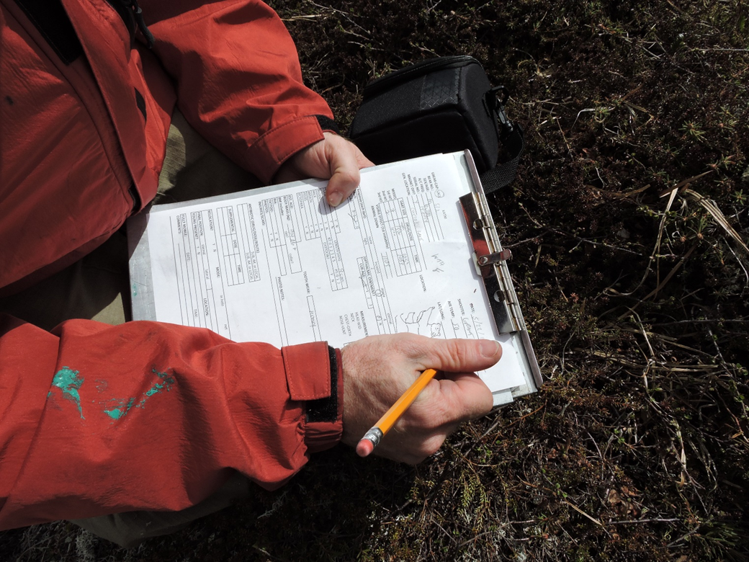
Biologist Data
Biologists also collected hair samples and measured the brown bears’ weight and body fat percentage.

Slide 4
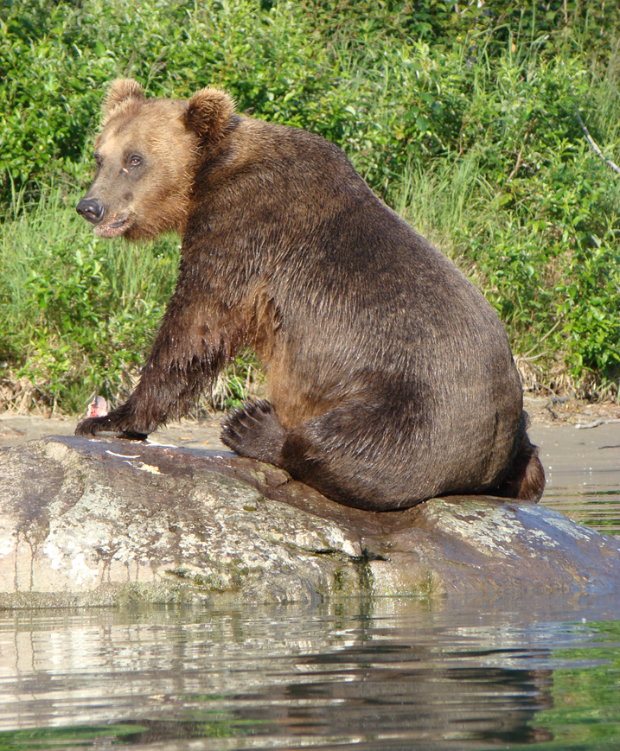
Let’s meet some of the bears!
Let’s meet some of the bears!

Slide 5
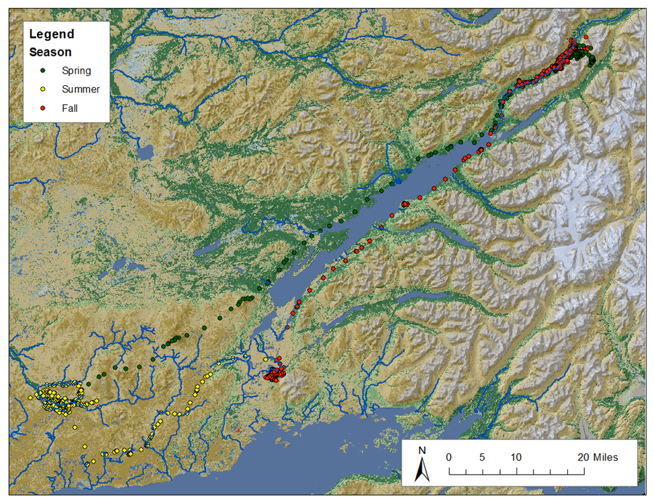
Bear 401
Bear 401 is a female without cubs.
She ate a high proportion of salmon.

Slide 6
Bear 405
Bear 405 is a female with one cub.
Her diet was 43% meat and 57% vegetation.
Her body mass was 129kg (285lbs), with 34.5% body fat.

Slide 7
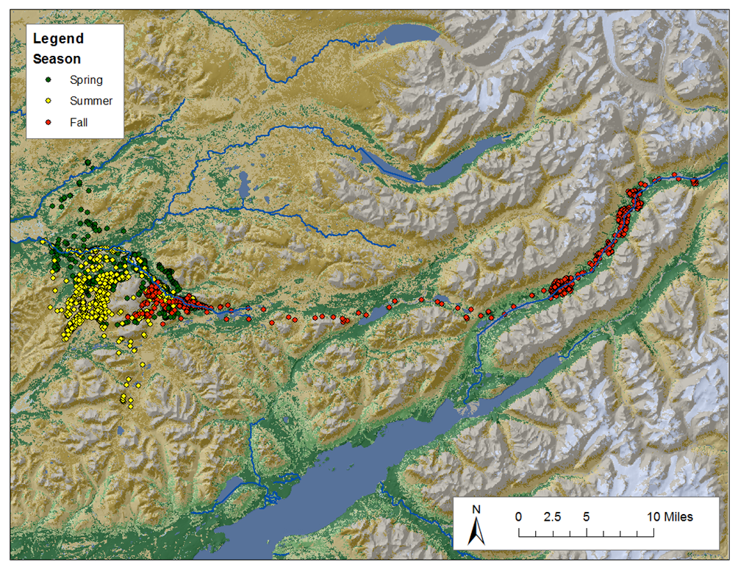
Bear 417 in 2015
Bear 417 is a solitary female.
Her diet was 78% meat and 22% vegetation.
She weighed 186.71 KG (411 lbs).

Slide 8
Bear 417 in 2016
In 2016, Bear 417 had three cubs.
How did her movement change from 2015 to 2016?

Slide 9
Bear 421
Bear 421 is a male who weighs 227.85 KG (502 lbs).
His diet is 83% meat and 17% vegetation.
He has a 31.2% body fat.

Slide 10
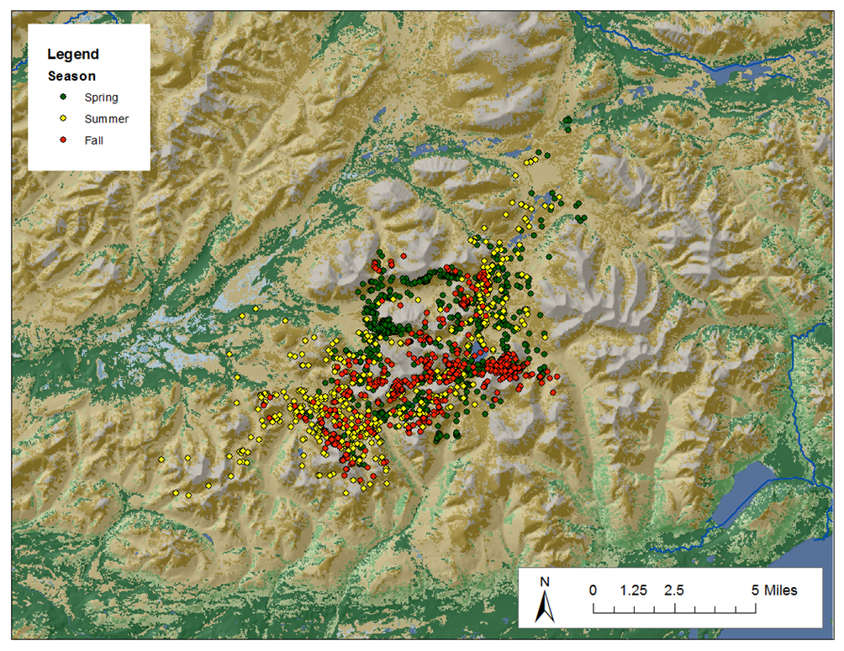
Bear 425
Bear 425 is a solitary male.
His diet was 40% meat and 60% vegetation.

